Slide 1
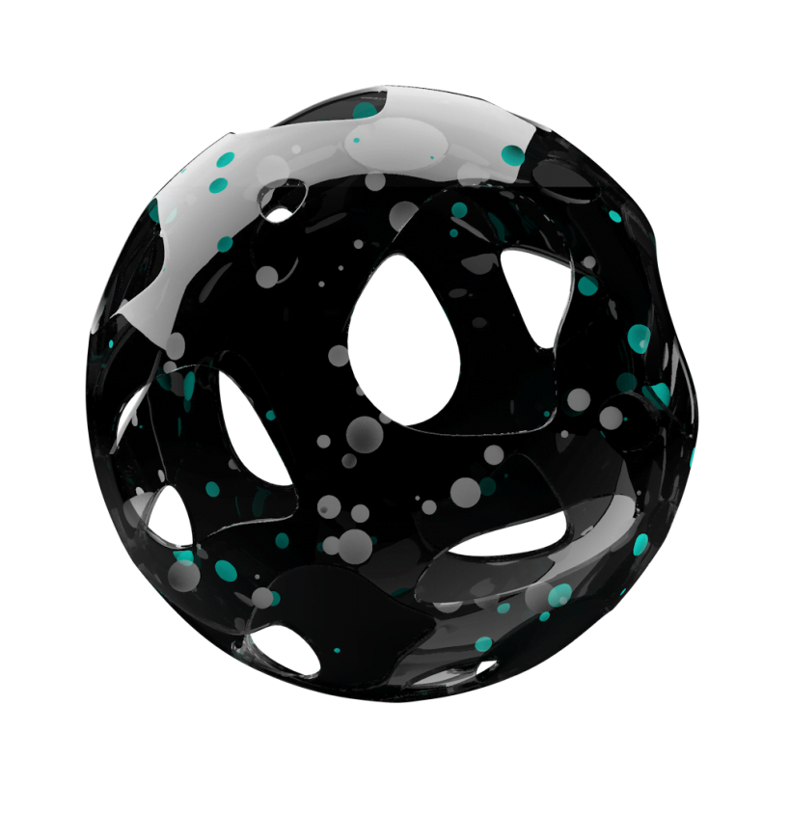
Privacy
And
Voice Screening
For Environmental Sound Identification
Notes:
Imagine you’re on holiday with your partner or your family. You have your own private corner of bush, no one else around. You relax, explore, spend time together. Then, one month later, you find out that your conversations were recorded and someone in an office three hours away has listened to them. How would you feel?

Slide 2
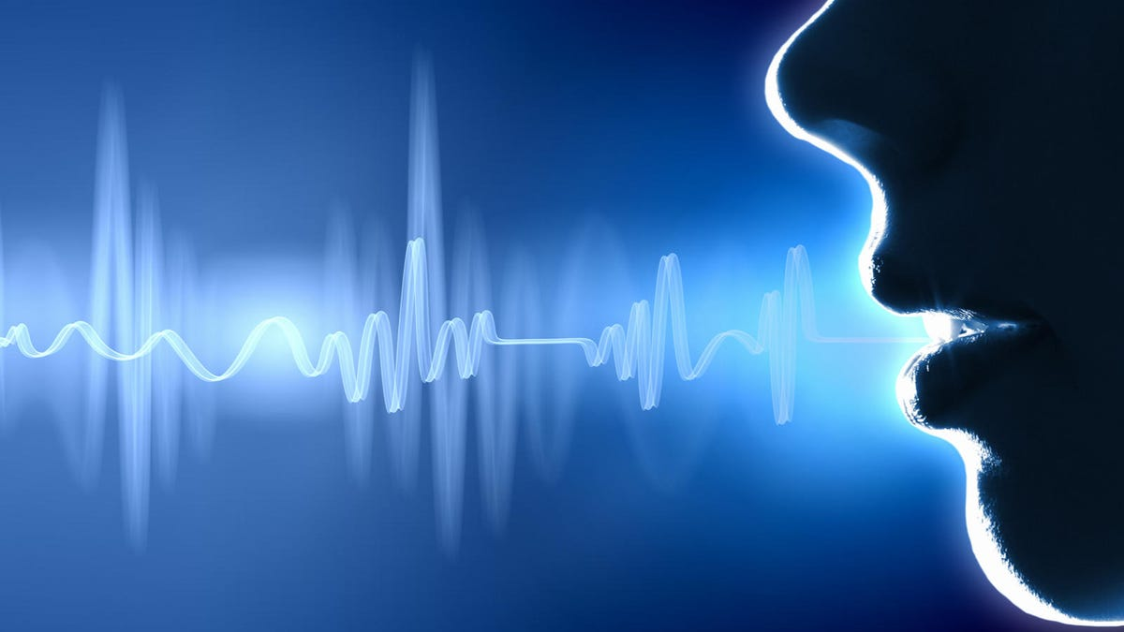

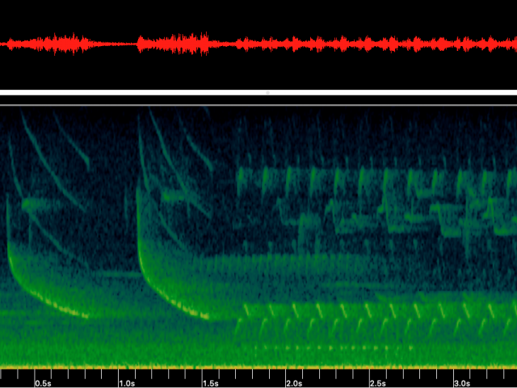
The Privacy Problem
How would you feel
if a private conversation was recorded
without your consent?
Notes:
I think most people would be uncomfortable with this. Their privacy was violated.
Why would this happen?

Slide 3

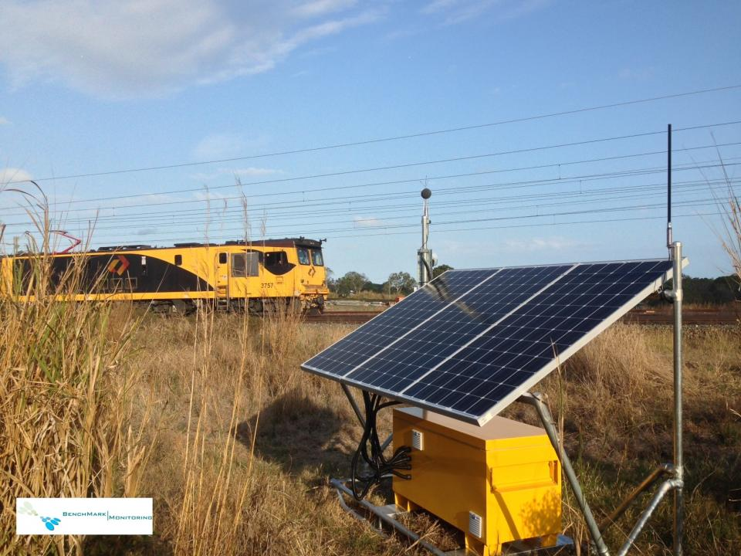
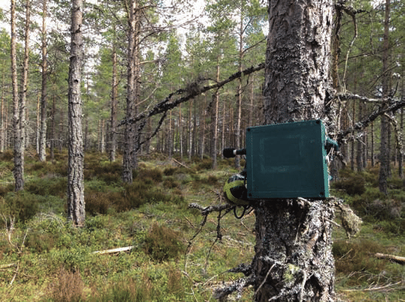
The Contexts : Environmental Sound Identification
For Industrial Noise Management
For Environmental Management
Notes:
Environmental sound identification - using AI/Machine learning to classify audio
Industrial applications: measure noise pollution, track vehicle movement Environmental applications - survey bird/insect/frog populations, track human or animal movements
Requires high quality sound data – hence voice and conversations are recorded

Slide 4
What is the Current Solution?
NOTHING!
Notes:
What is currently being done to protect the privacy of people near the monitors?
*shrug*
So we came up with a solution

Slide 5




The Solution - Pre-Screening
Preprocessing
ML Model – Voice Yes / No
Does this contain voice data?
Raw Audio Data
Yes
No
Discard data
Continue routine assessment
Notes:
Develop a simple ML model that can identify whether or not audio data contains a voice – by keeping the model goals small, time, computation, and power consumption is minimal
Install on the device in the field and apply immediately after recording
If voice is identified, exclude the data from further analysis and mark it as voice (for traceability)
The monitor functions as normal, but voice data is excluded at the earliest possible point in the process (and is never stored) – minimising privacy impacts

Slide 6
What We Bring to Target Customers
Protection
from legal concerns
Responsible practice
Less data to store
Notes:
For manufacturers and operators of noise logging systems, our solution provides multiple benefits all with minimal impact to current operation
-Responsible practice – promote to your customers and to the general public
-Less data to store
-Protection from legal concerns

Slide 7

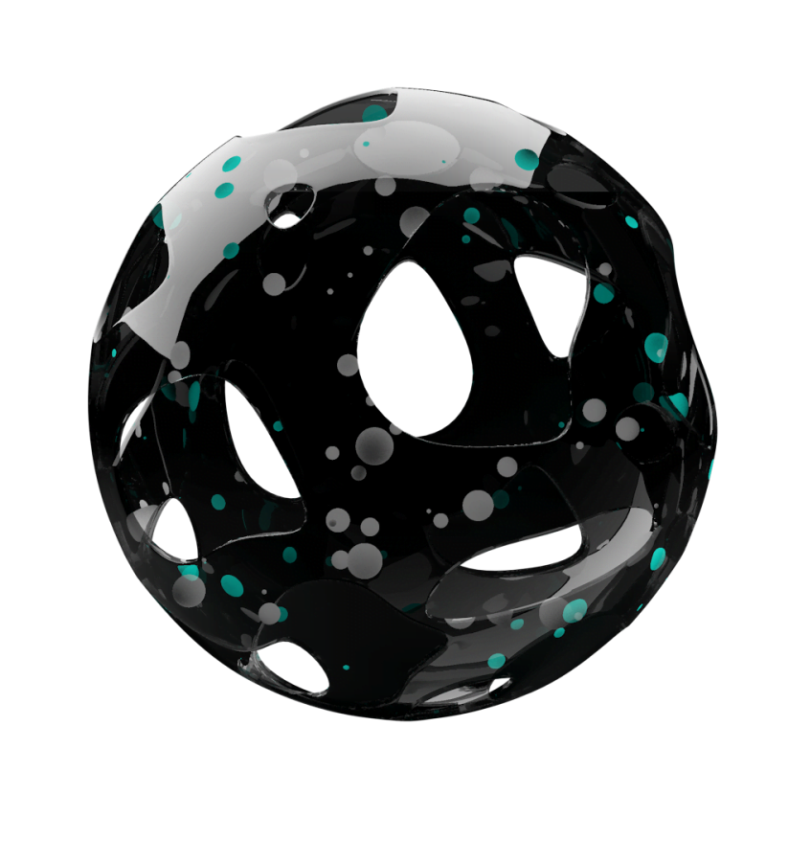
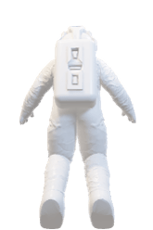
THA
NKS

Slide 8
Why our solution？
Minimal impact to the monitor’s function
Prevents sensitive data from being stored
Data is screened at earliest possible point in the process
Notes:
The monitor can still function as normal
Sensitive data is never stored – removes privacy concerns as early as possible
Importantly, it’s streamlined
By focusing on only whether data is voice or non-voice, much less computation is required than standard voice recognition

Slide 9



The Solution Details
Once sufficient data is cached (~5s), apply speech recognition model
Cache of input data
Input data 1/3 octave, short time step (<1 s, often 125 ms)
Speech recognised
No speech recognised
Cache data waiting for voice screening
Set data in cache to 0
(do not delete entry, just clear values)
Core data analysis/ML classification
Release cached data

Slide 10

Important Goals
The rest of the system works just as well
Adaptable inputs
Accurate classification
Traceability
Low resource use
行业PPT模板http://www.1ppt.com/hangye/
Notes:
Voice identification shouldn’t compromise the system’s function
Ideally work with whatever the system’s input is – our process should be adaptable
Clearly record when data is excluded
Monitors are usually in remote environments - power and network connection comes at a cost
Ensure representative voice identification (vocal range, accent, language)

